Slide 1


NTUA Top Tagger Tag & Probe methodology
George Bakas

Slide 2
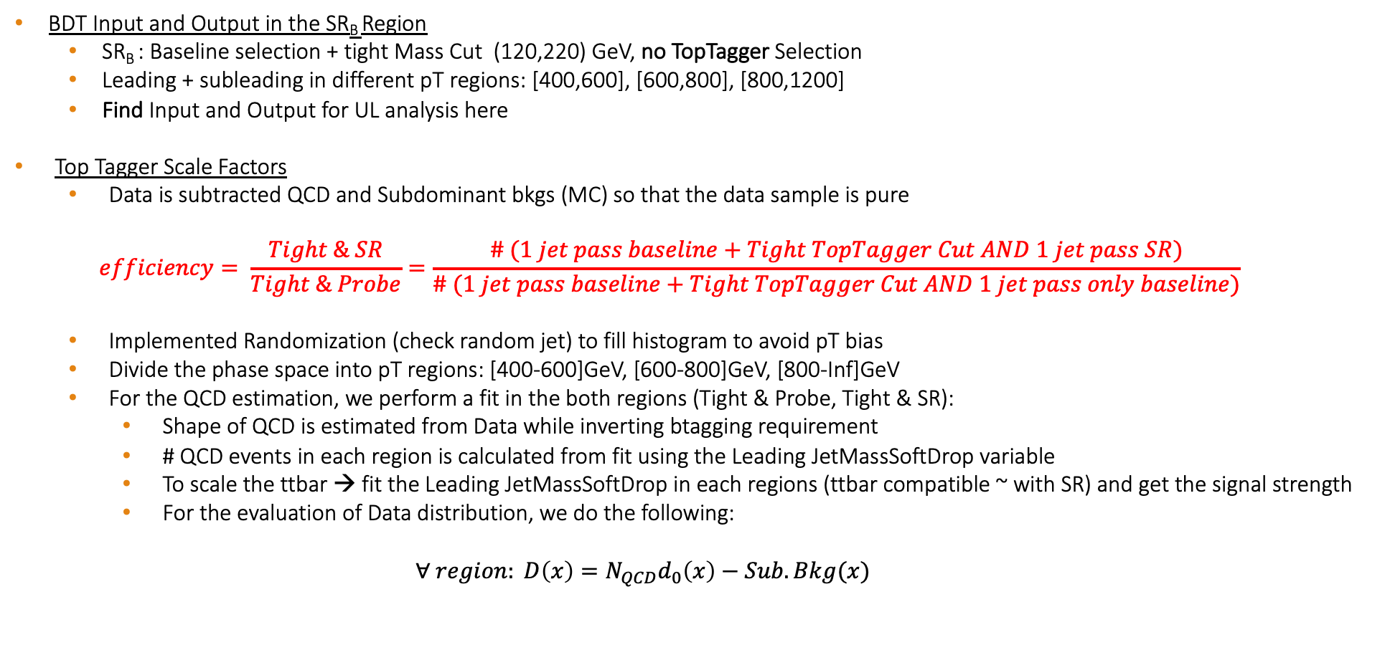
Overview
BDT Input and Output in the SR_{B} Region
SR_{B} : Baseline selection + tight Mass Cut (120,220) GeV, no TopTagger Selection
Leading + subleading in different pT regions: [400,600], [600,800], [800,1200]
Find Input and Output for UL analysis here
Top Tagger Scale Factors
Data is subtracted QCD and Subdominant bkgs (MC) so that the data sample is pure
$$efficiency= \frac{Tight \& SR}{Tight \& Probe}=\frac{\# (1 jet pass baseline+Tight TopTagger Cut AND 1 jet pass SR)}{\# (1 jet pass baseline+Tight TopTagger Cut AND 1 jet pass only baseline)}$$
Implemented Randomization (check random jet) to fill histogram to avoid pT bias
Divide the phase space into pT regions: [400-600]GeV, [600-800]GeV, [800-Inf]GeV
For the QCD estimation, we perform a fit in the both regions (Tight & Probe, Tight & SR):
Shape of QCD is estimated from Data while inverting btagging requirement
# QCD events in each region is calculated from fit using the Leading JetMassSoftDrop variable
To scale the ttbar → fit the Leading JetMassSoftDrop in each regions (ttbar compatible ~ with SR) and get the signal strength
For the evaluation of Data distribution, we do the following:
$$∀ region: D\left(x\right)=N_{QCD}d_{0}\left(x\right)−Sub.Bkg(x)$$

Slide 3
Signal Selection
Control Region Selection
Variables | Selected Cut
pT leading jets | > 450 GeV
pT 2nd leading jets | > 400 GeV
Njets | > 1
N leptons | = 0
|eta| (both leading jets) | < 2.4
mJJ | > 1000 GeV
jetMassSoftDrop (only for fit) | (50,300) GeV
Top Tagger | > 0.2
B tagging (2 btagged jets) | > Medium WP
Signal Trigger
Variables | Selected Cut
pT leading jets | > 450 GeV
pT 2nd leading jets | > 400 GeV
N leptons | = 0
|eta| (both leading jets) | < 2.4
mJJ | > 1000 GeV
jetMassSoftDrop (only for fit) | (50,300) GeV
Top Tagger | > 0.2
B tagging (0 btagged jets) | < Medium WP
Control Trigger

Slide 4
TagAndProbe Efficiency per Pt region (2016_preVFP)
pT [400,600]GeV
pT [600,800]GeV
pT [800,Inf]GeV

Slide 5
TagAndProbe Efficiency per Pt region (2016_postVFP)
pT [400,600]GeV
pT [600,800]GeV
pT [800,Inf]GeV

Slide 6
TagAndProbe Efficiency per Pt region(2017)
pT [400,600]GeV
pT [600,800]GeV
pT [800,Inf]GeV

Slide 7
TagAndProbe Efficiency per Pt region(2018)
pT [400,600]GeV
pT [600,800]GeV
pT [800,Inf]GeV

